Slide 1
Java Class
Day 6

Slide 2





Jul
Aug
Big Data Analyst(10/1)
ADsP(8.28) 8/1~8/5
8/29~9/2
TOEIC(7/24) 6/6~7/11
TOEIC(8/07) 6/20~7/25
TEPS(7/16) 6/29~7/12
TEPS (8/06) 6/20~7/17
TOEIC(8/21) 7/ 4 ~ 8/ 8
TEPS (8/20) 7/ 4 ~7/31
www.toeic.co.kr
www.teps.or.kr
www.dataq.or.kr
austin.sogang.ac.kr
austiny.snu.ac.kr

Slide 3
Mon
Tue
Wed
Thu
1. Main
2. Main
3. Main
4. Main
LUNCH
5. Sub
6. Sub
7. Sub
8. Recap, Test
Fri
1. Recap Sub
2.
3.
4.
LUNCH
5. Recap Main
6.
7.
8. Test
Jul
Java Basic
Aug
Java Intermediate
Database
HTML, CSS, JS

Slide 4
Java
9 OOP
9.1 Class & Object
9.1.1 Basic
9.1.2 Advance
9.2 Methods & Variables
9.2.1 Basic
9.2.2 Advance
9.3 Exam

Slide 5
9 OOP 9.1 Class & Object

Slide 6
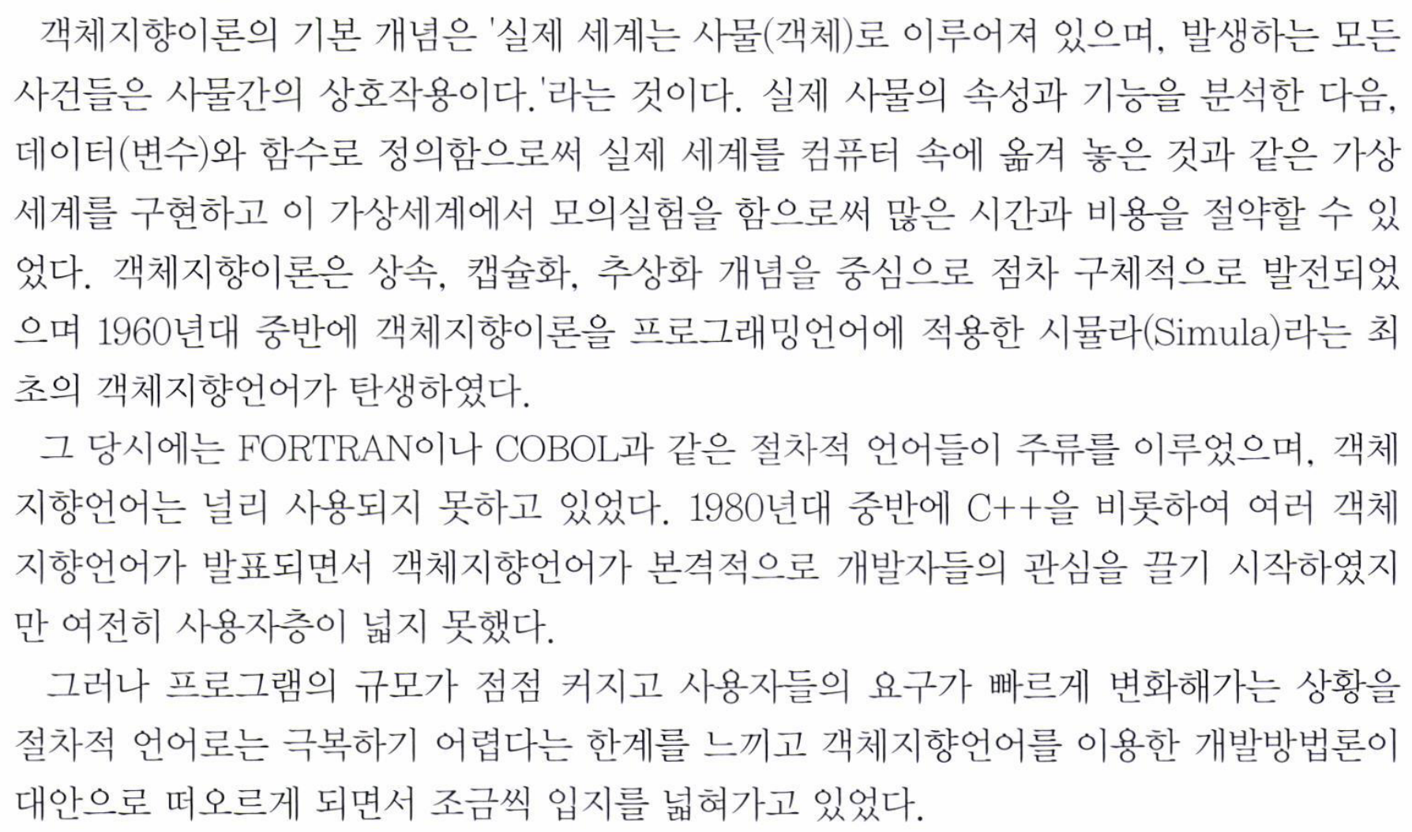

Slide 7
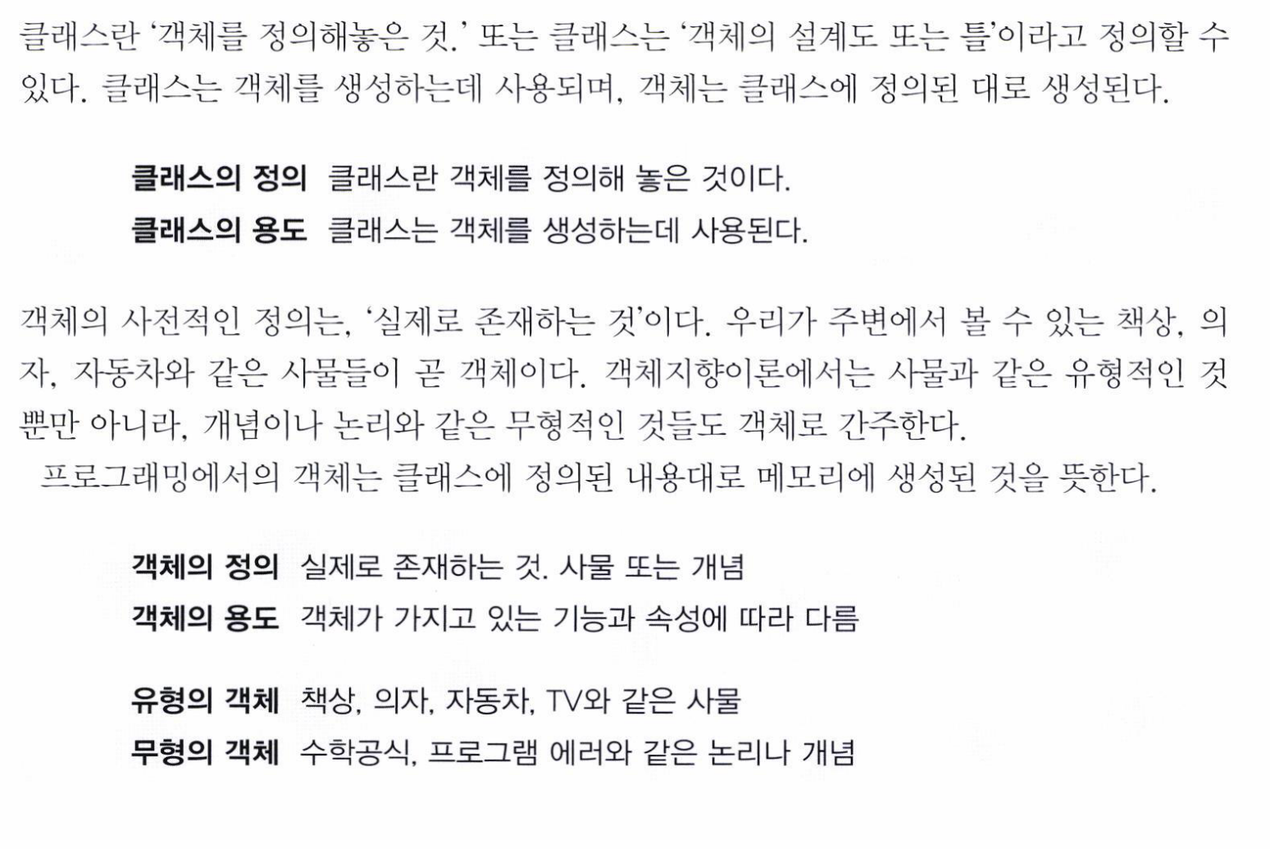

Slide 8
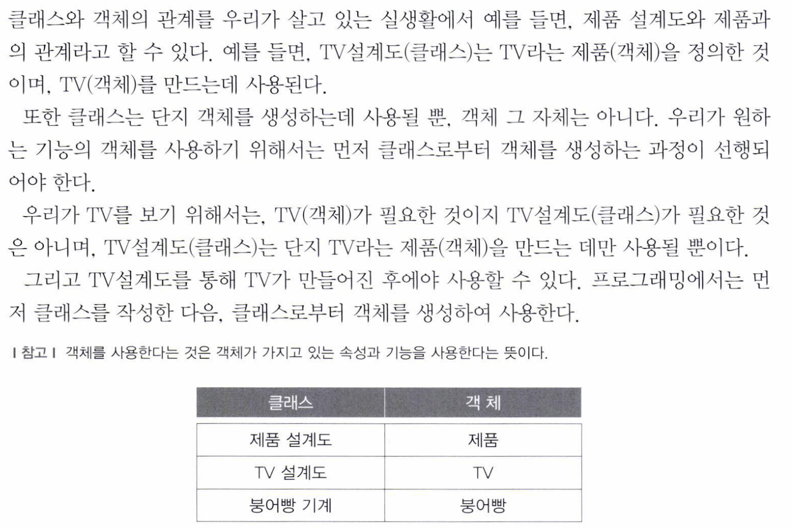

Slide 9
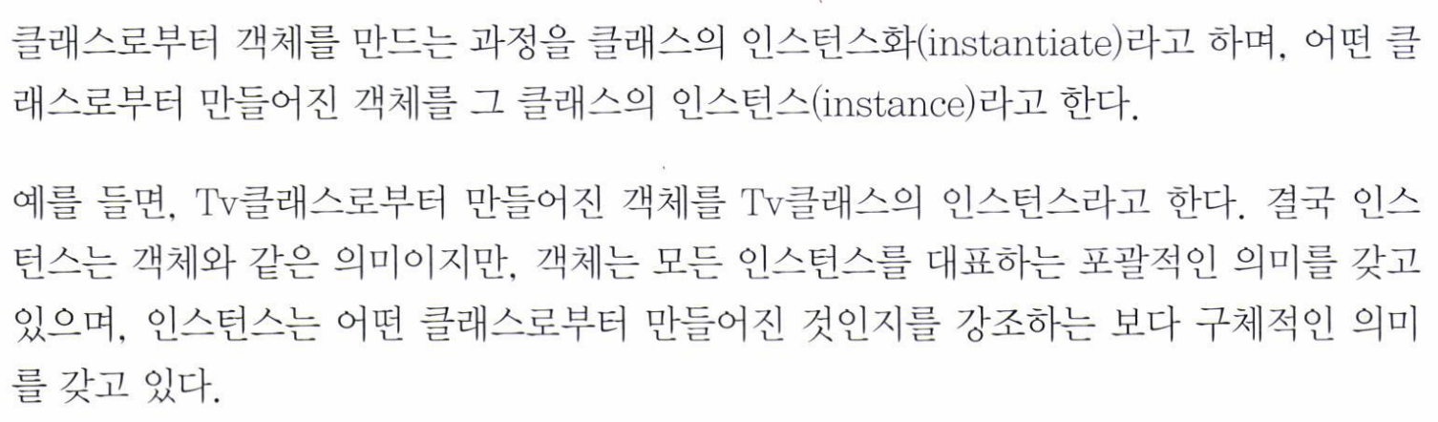
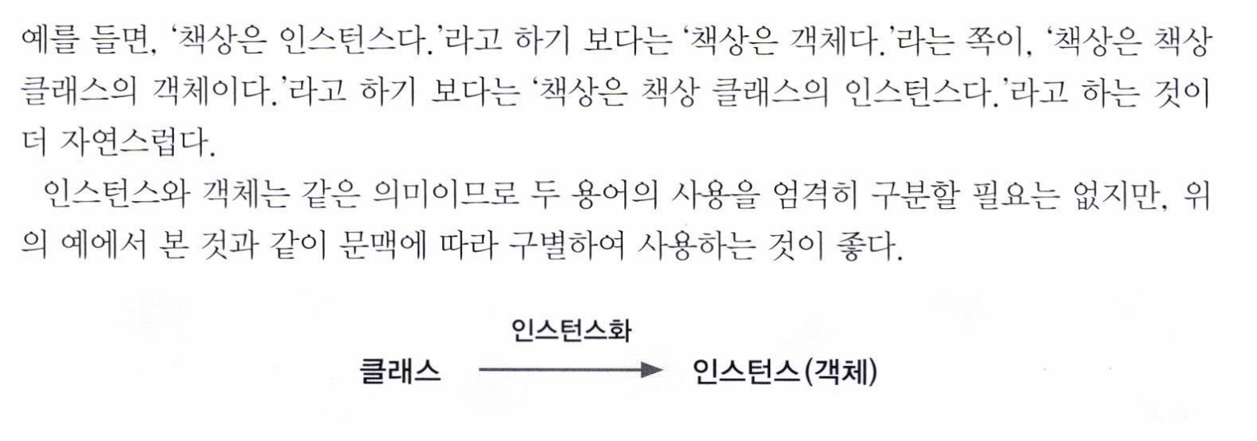

Slide 10
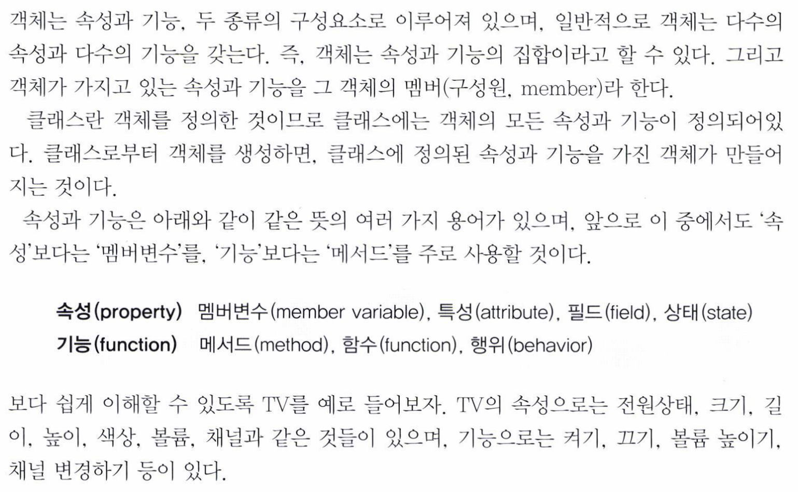

Slide 11
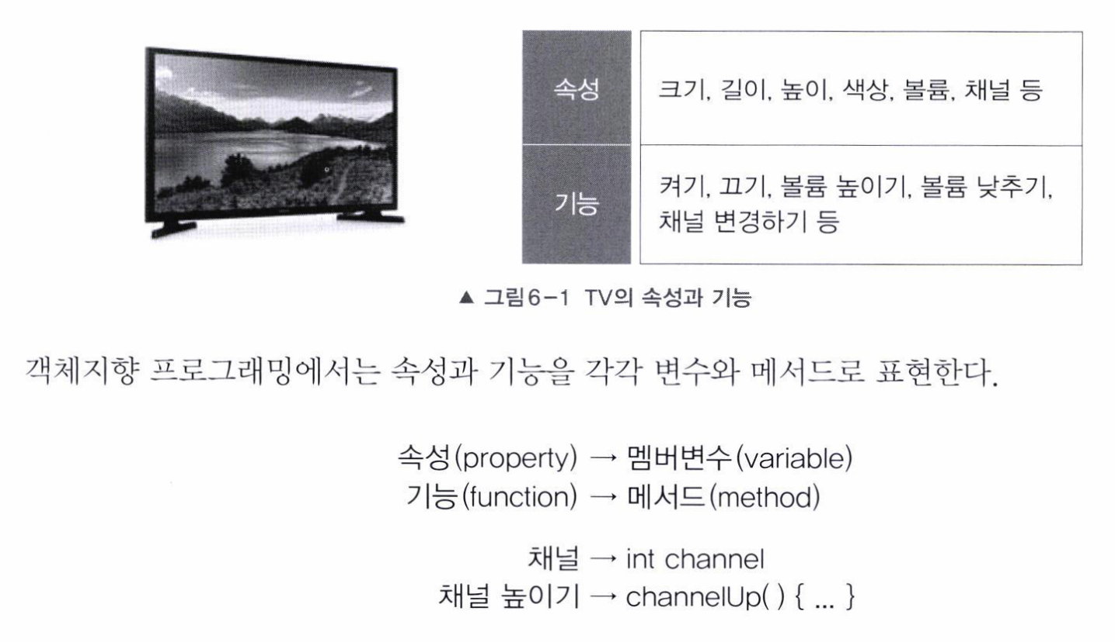

Slide 12
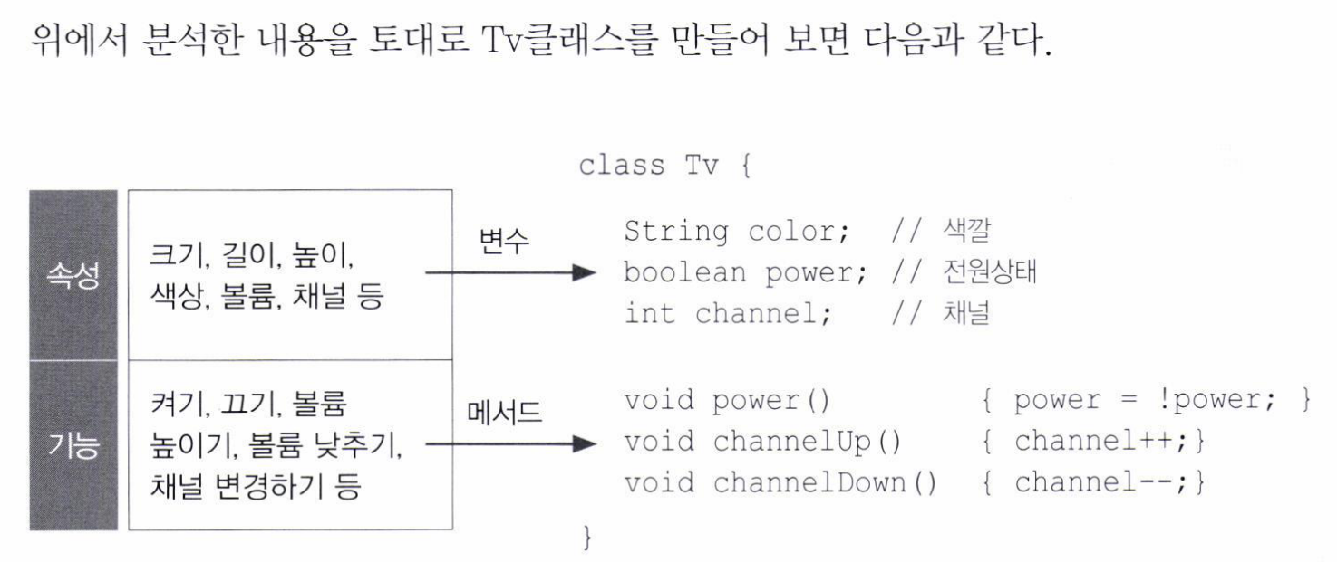

Slide 13
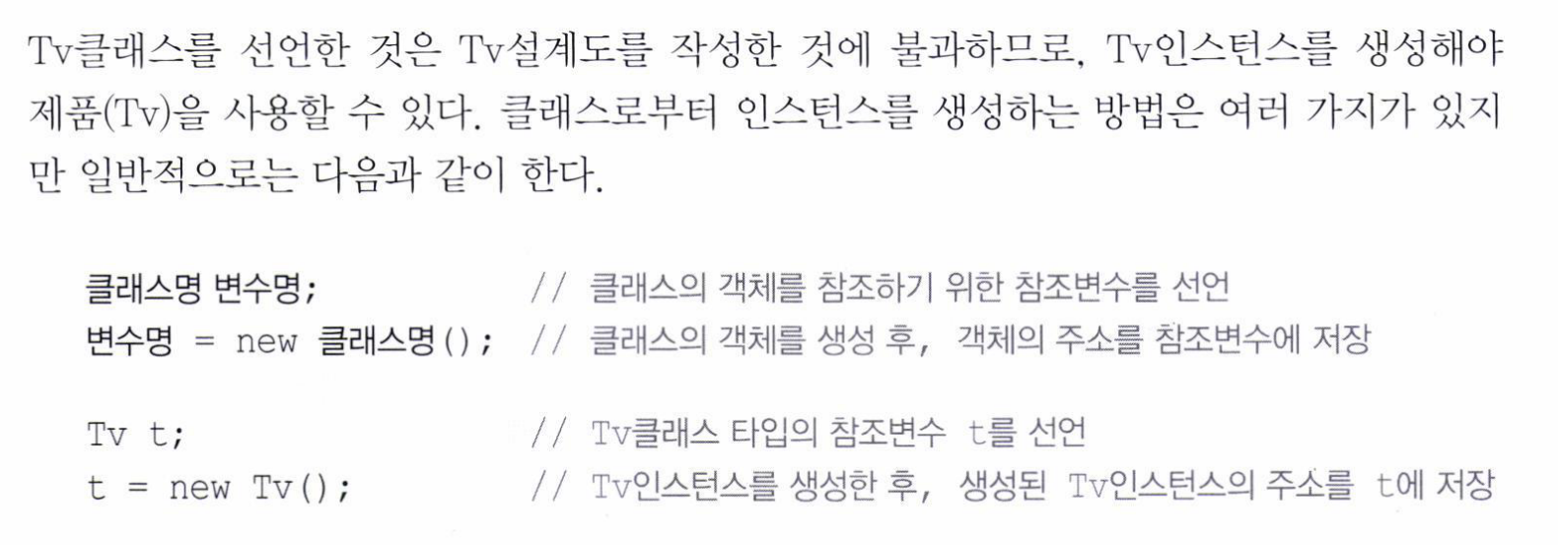

Slide 14
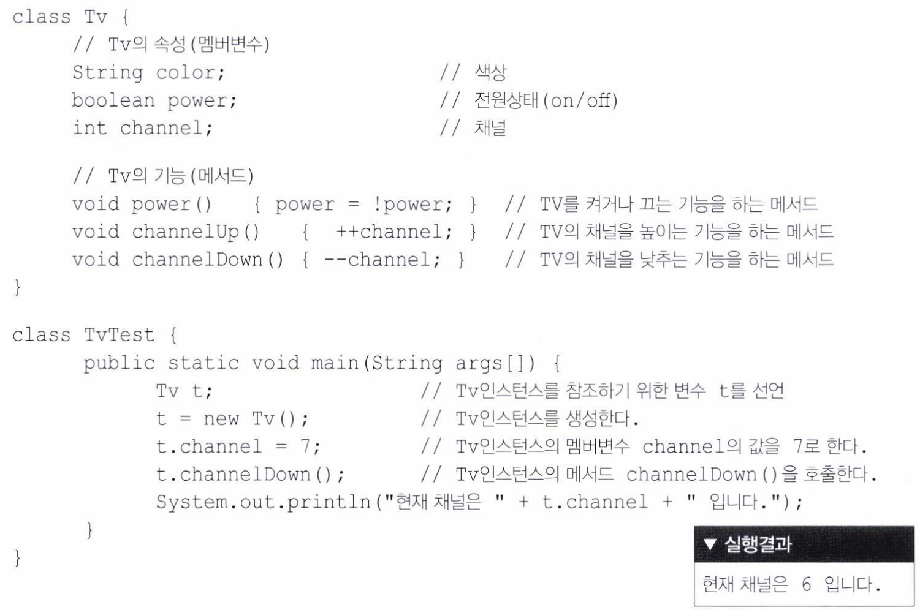

Slide 15
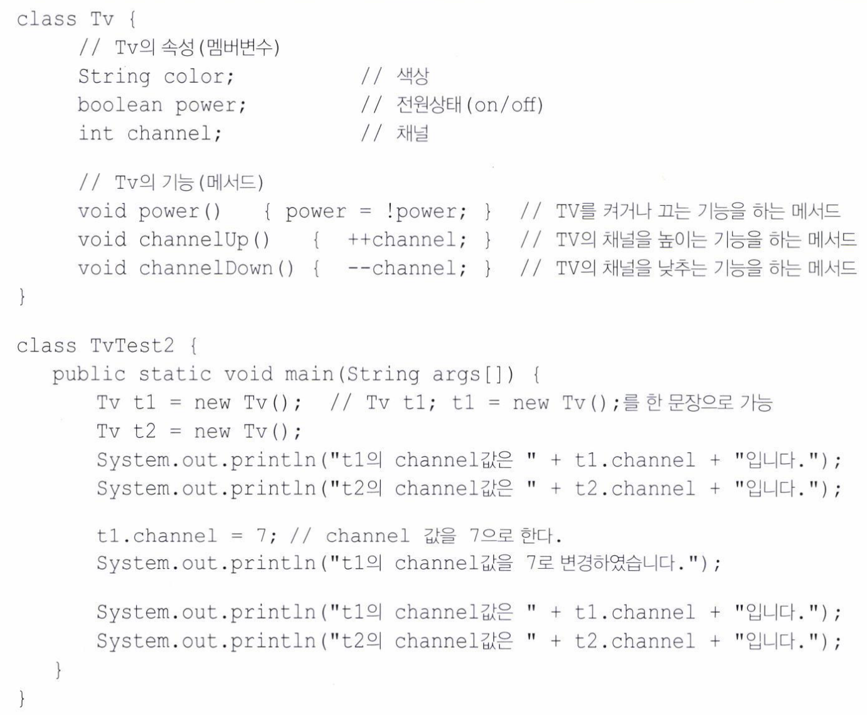
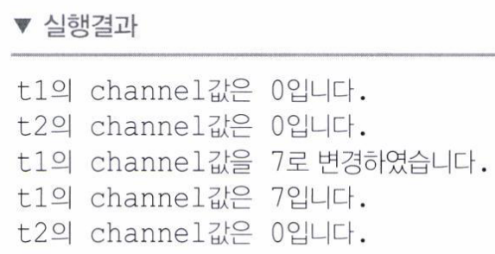

Slide 16
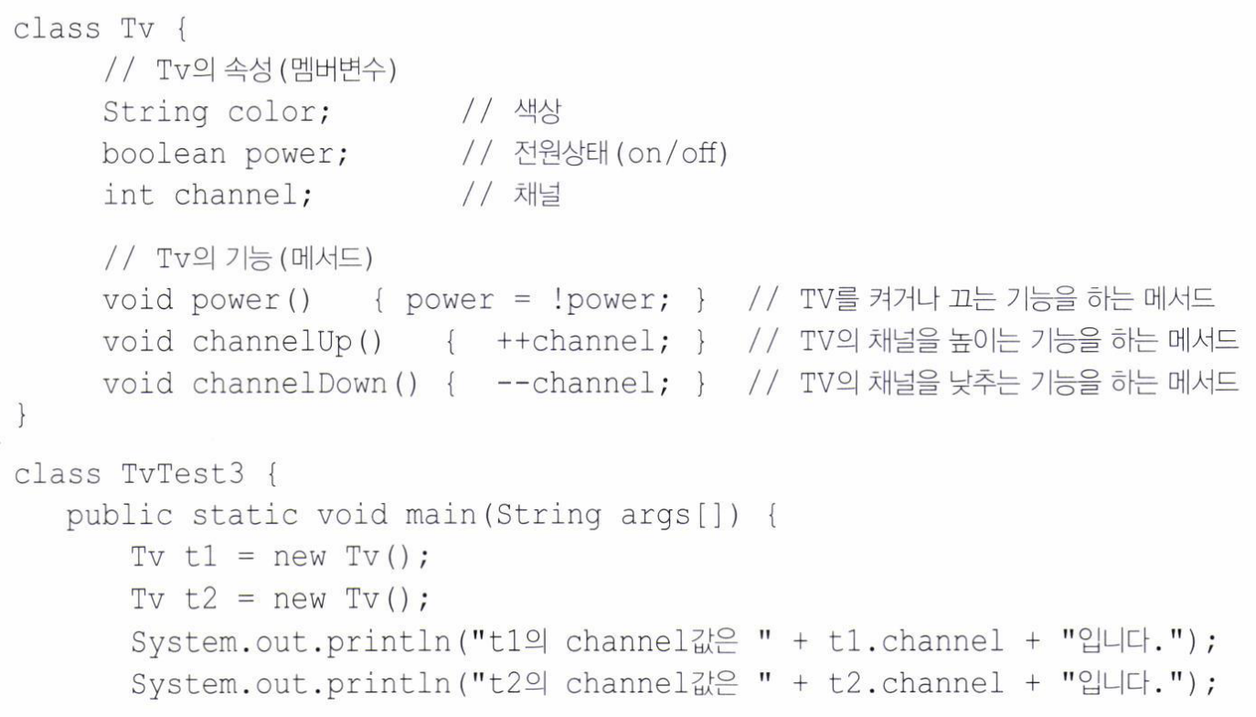
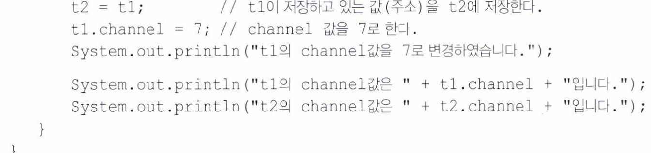
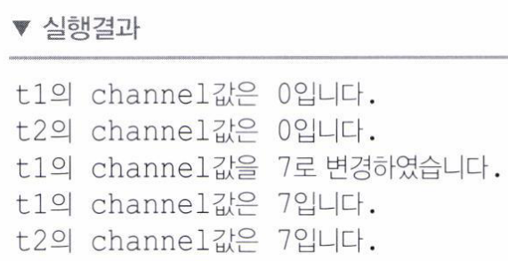

Slide 17
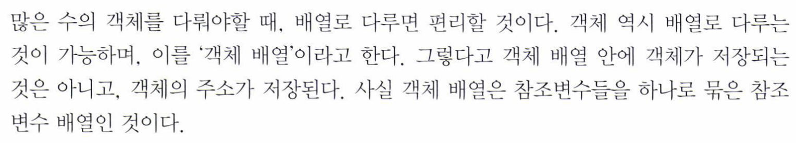
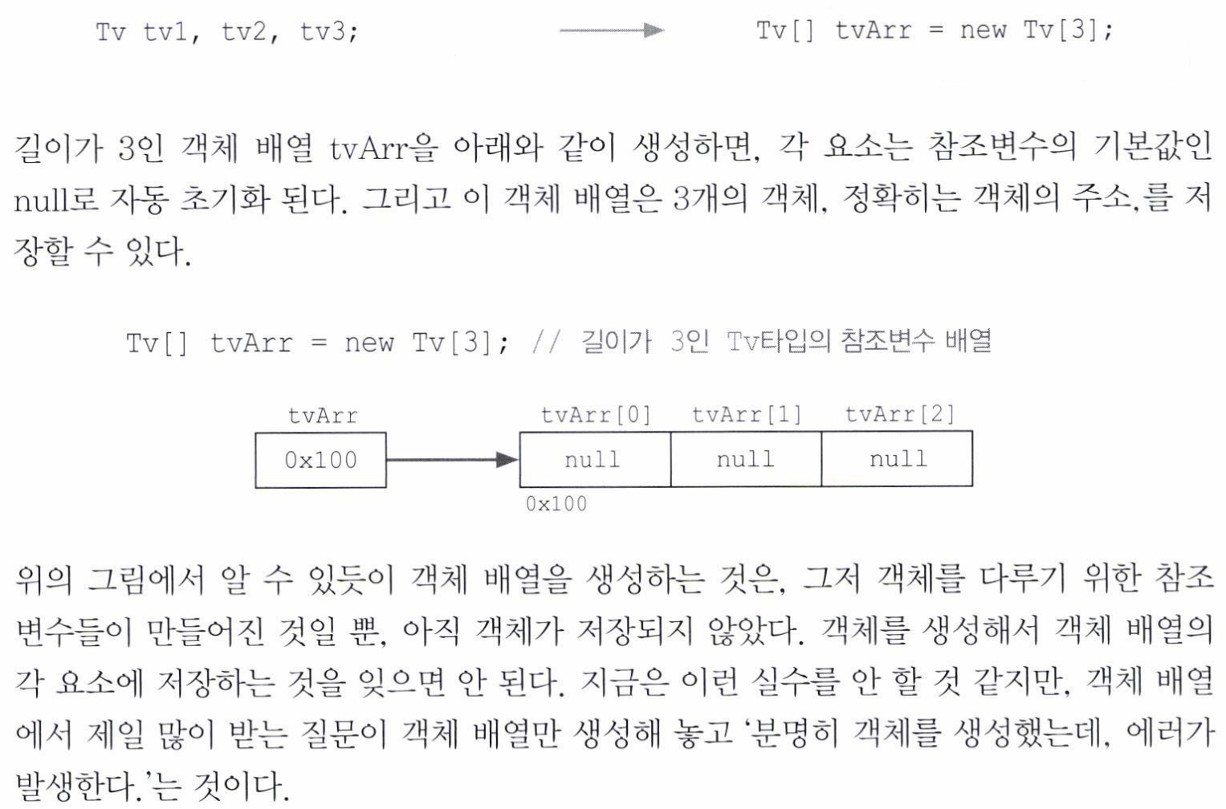

Slide 18
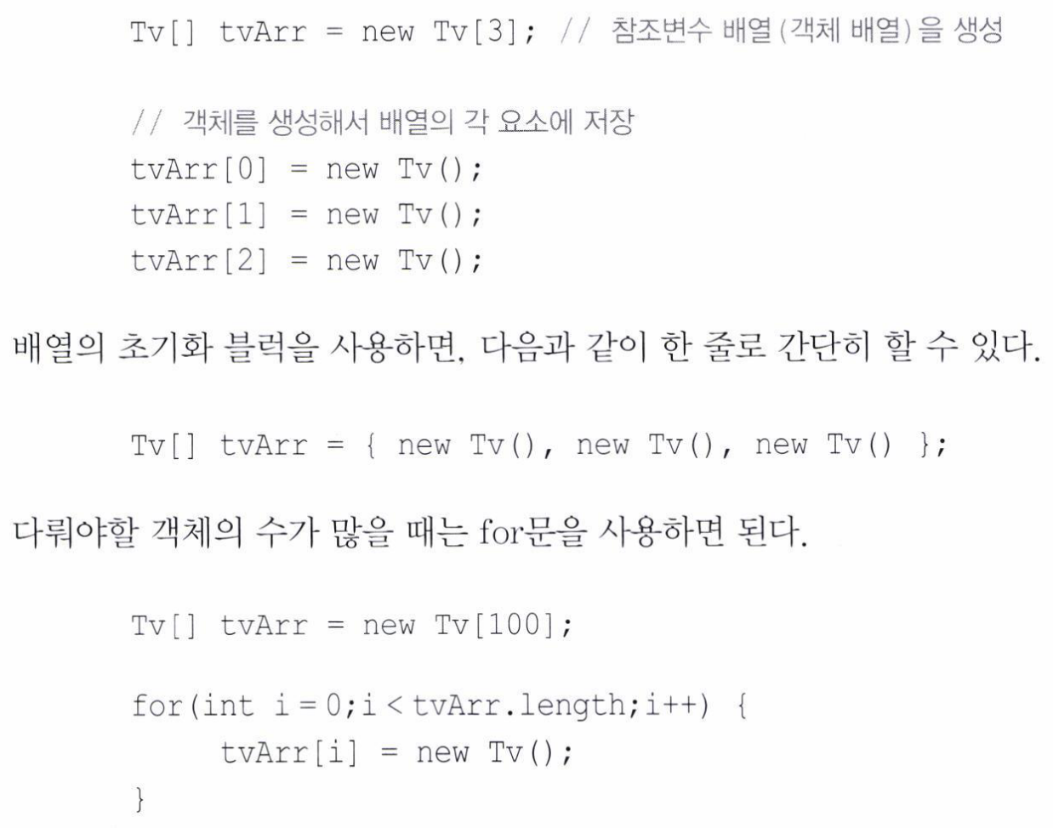

Slide 19
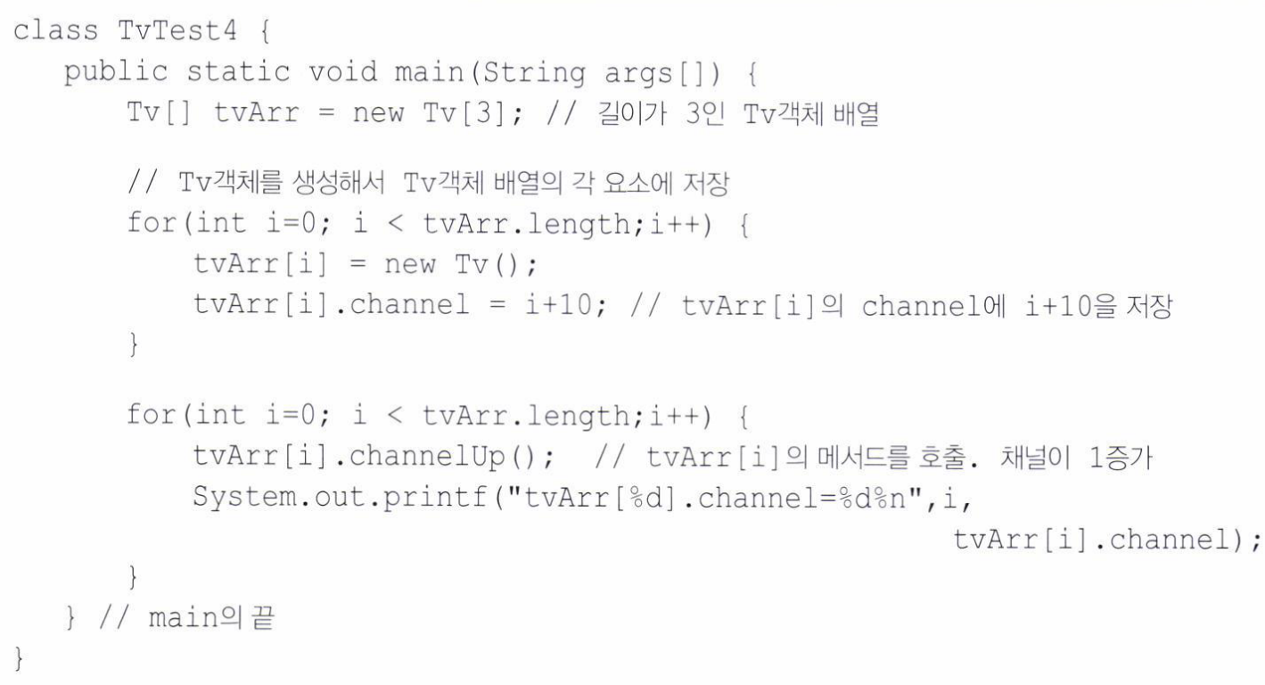
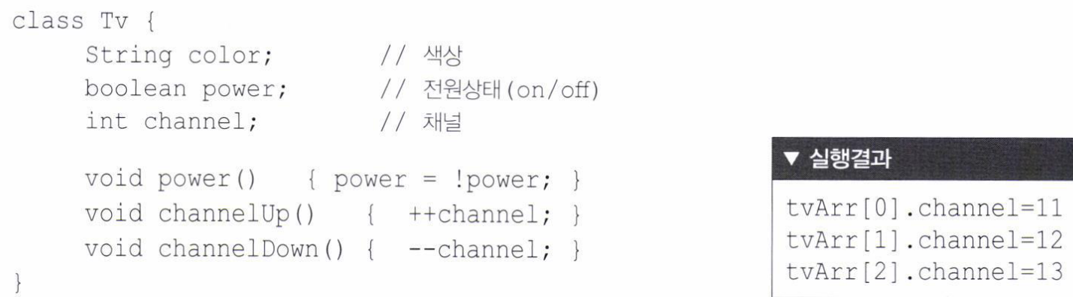

Slide 20
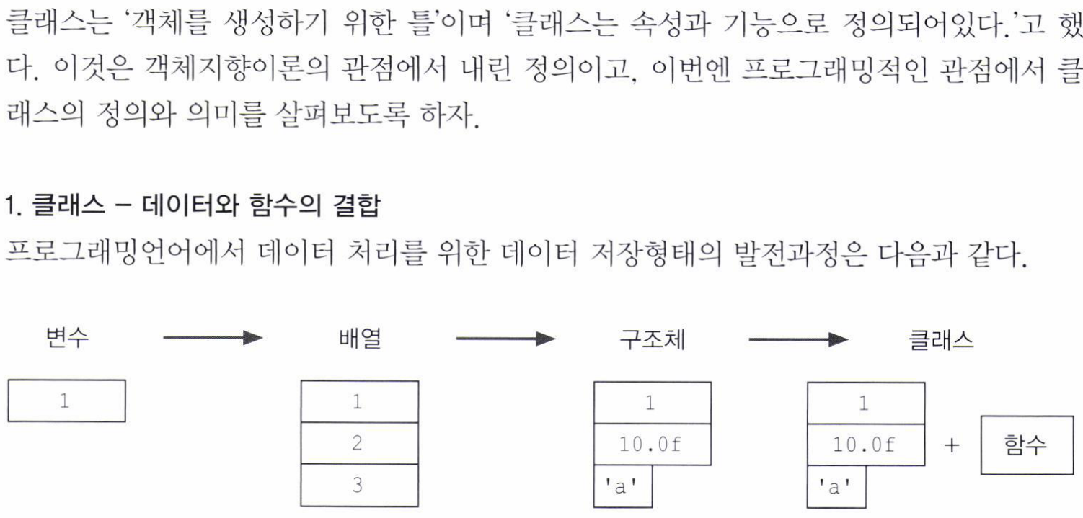
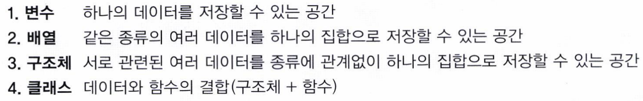

Slide 21
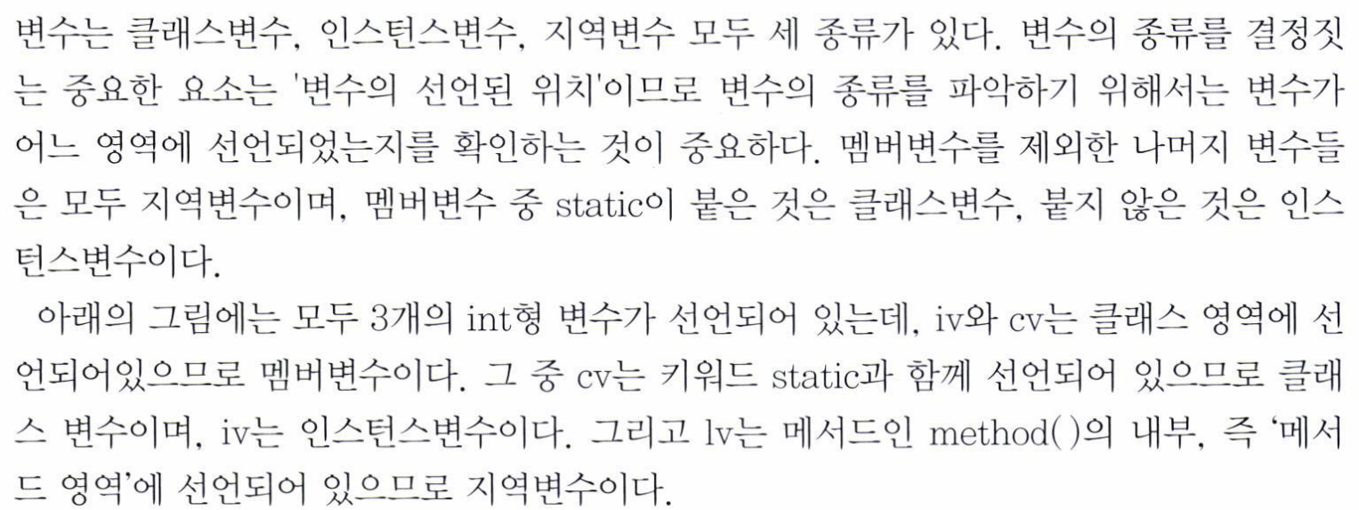
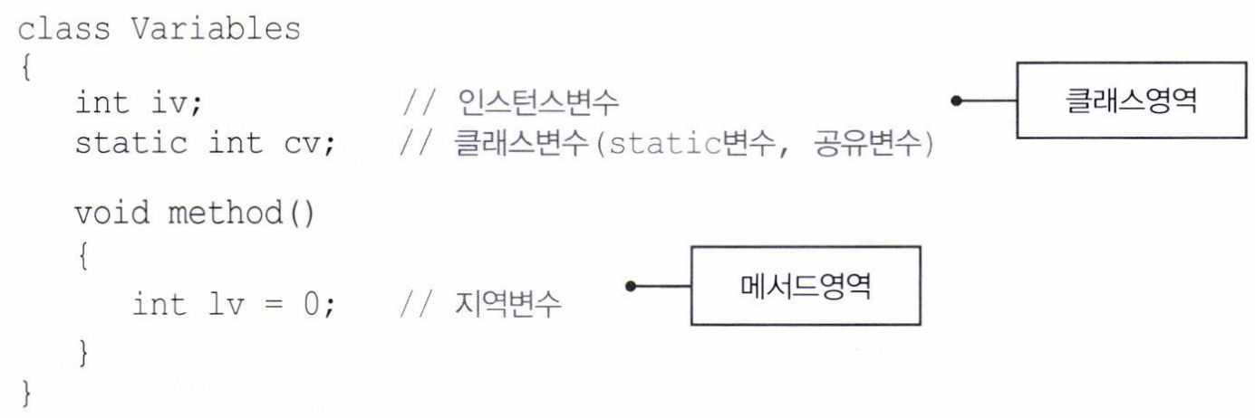

Slide 22
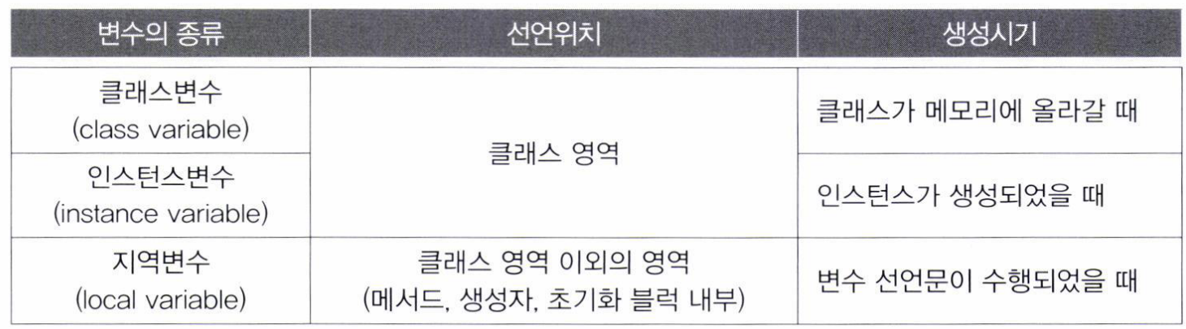

Slide 23
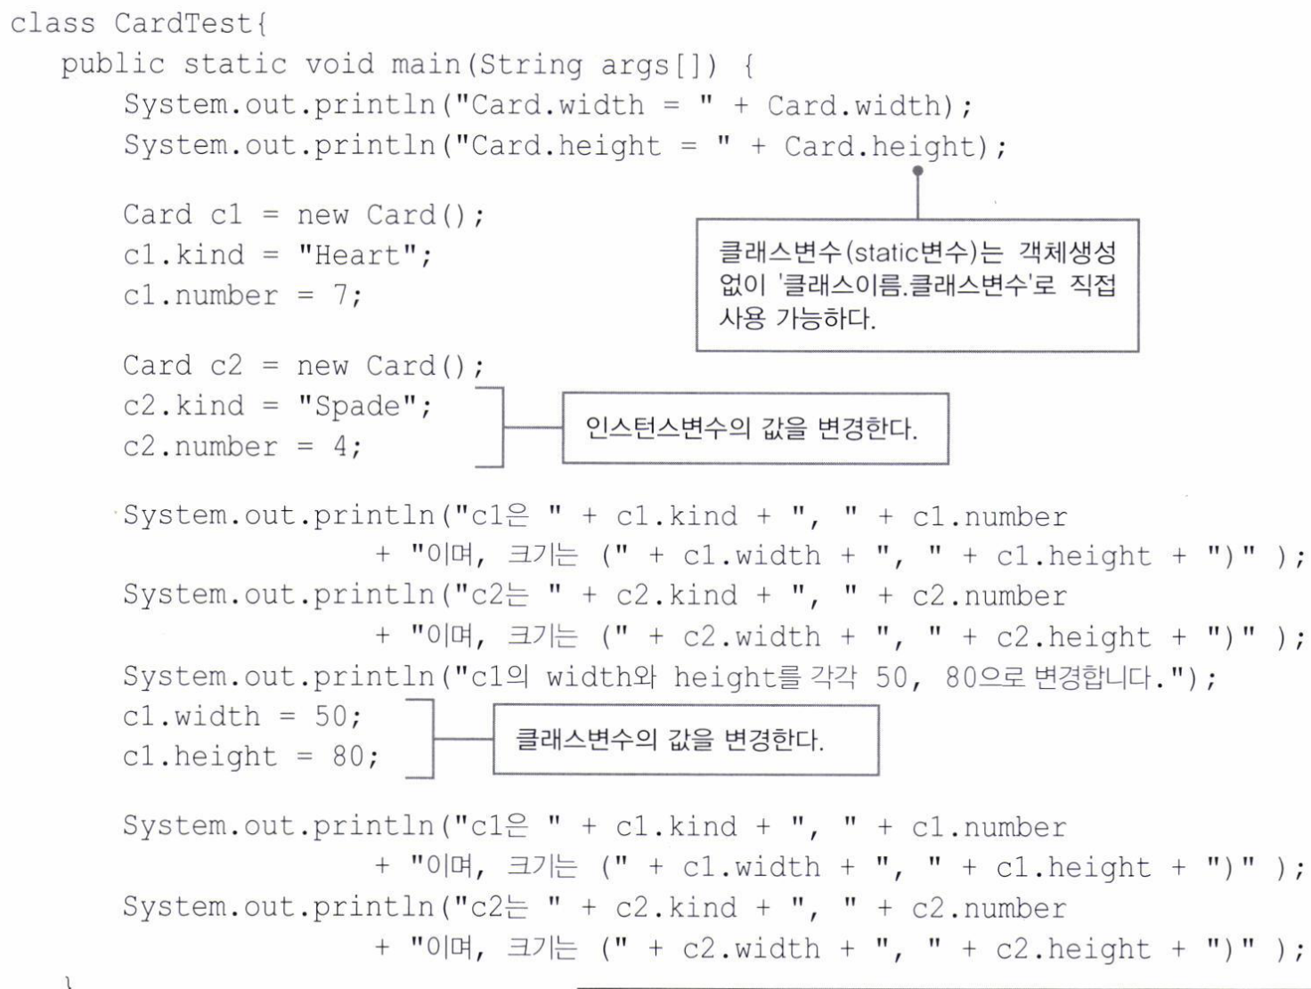
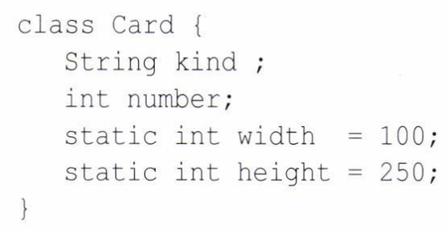
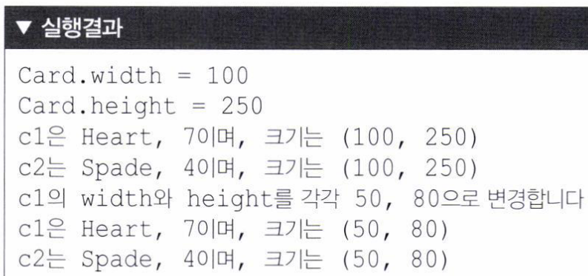

Slide 24
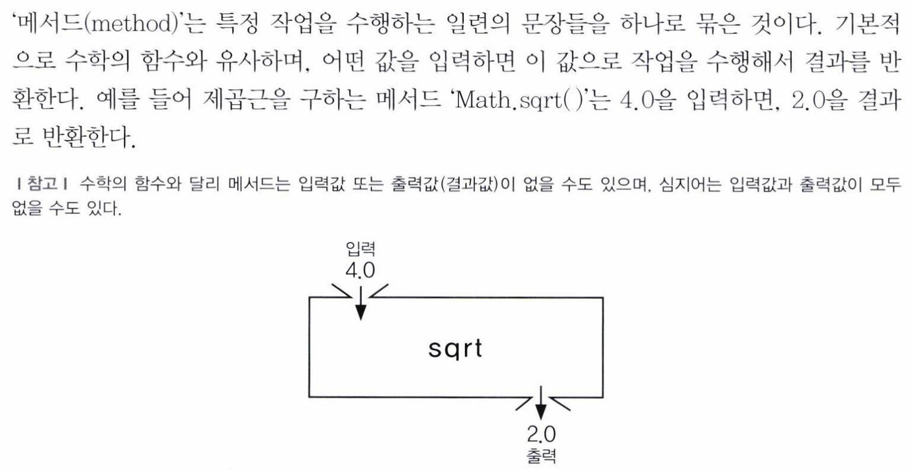
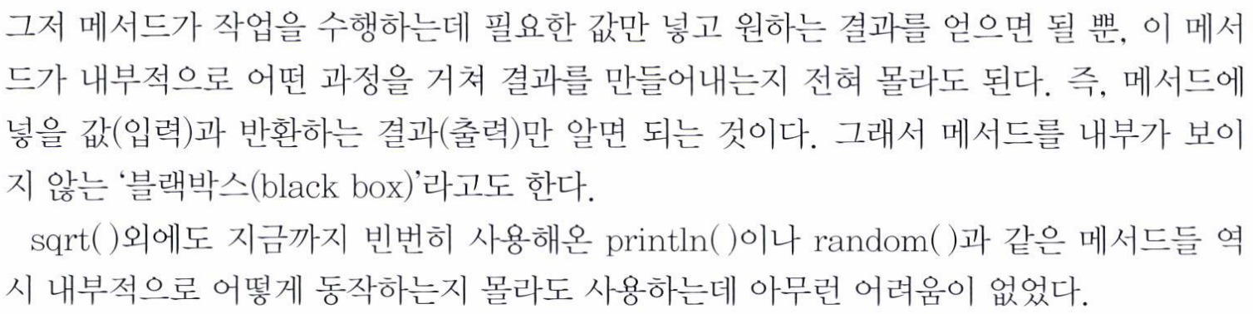

Slide 25

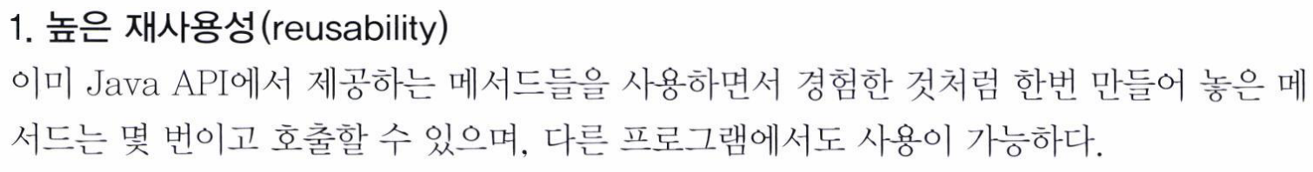
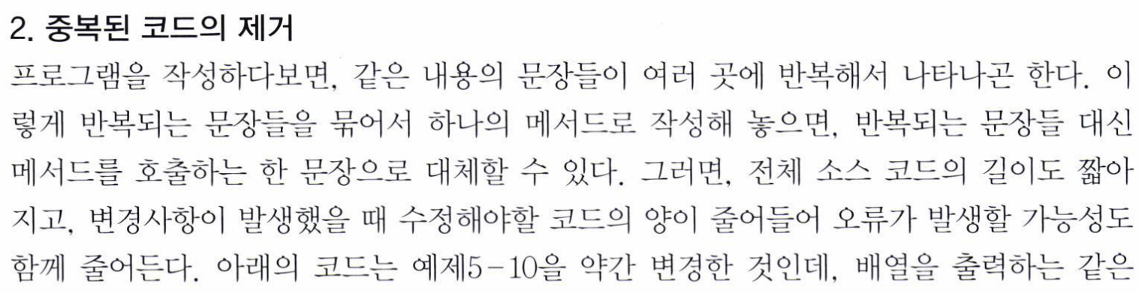
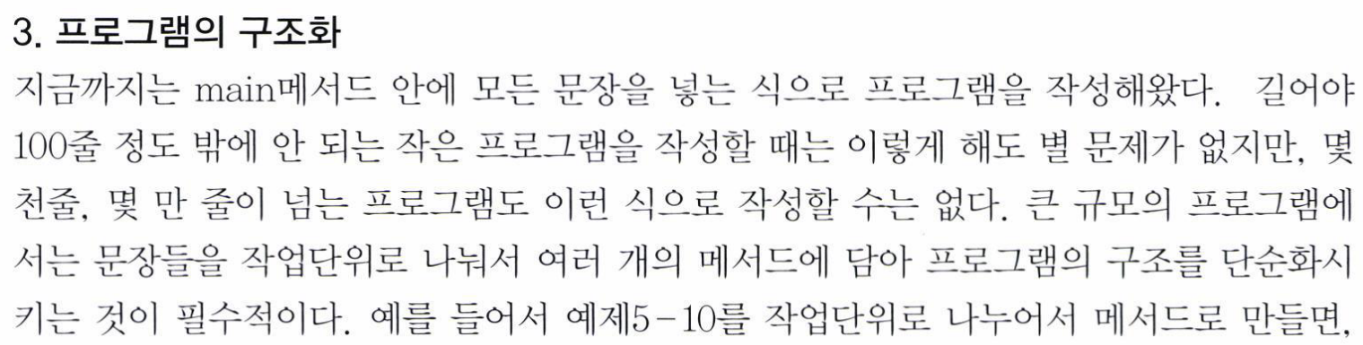

Slide 26
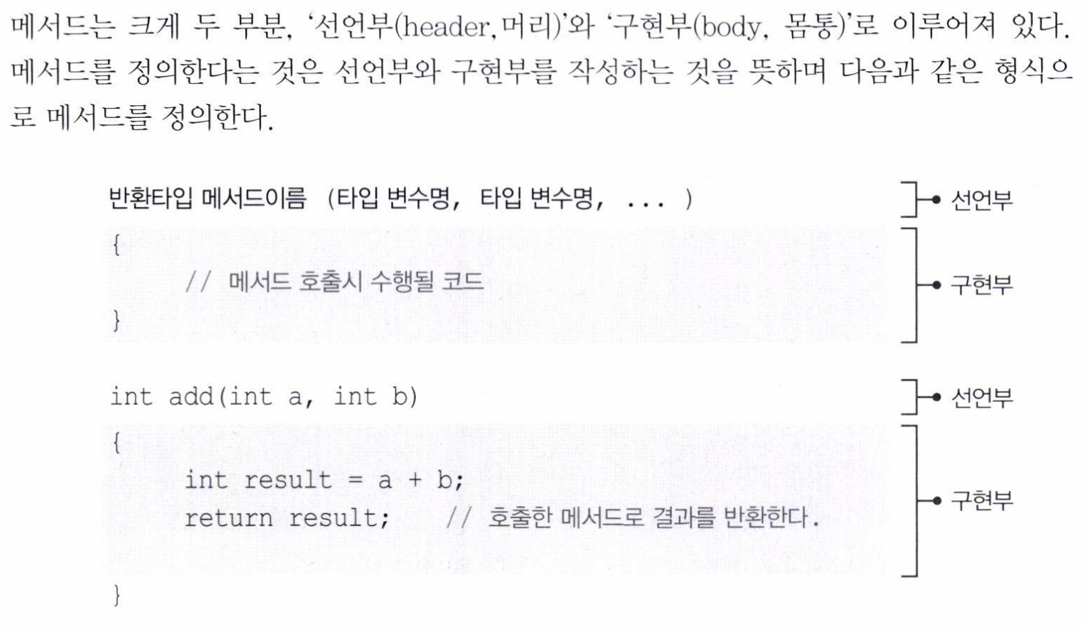

Slide 27
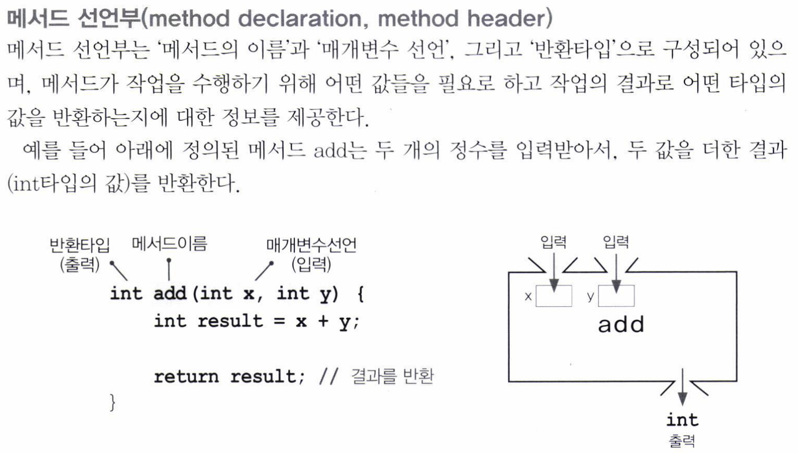

Slide 28
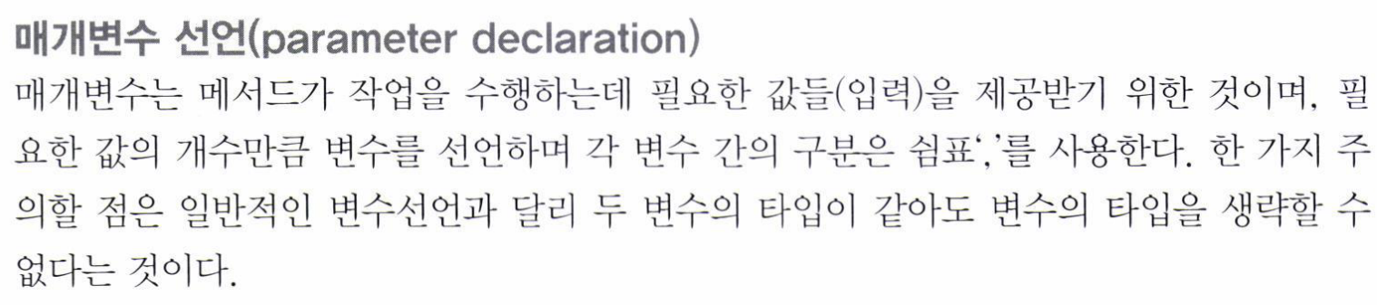
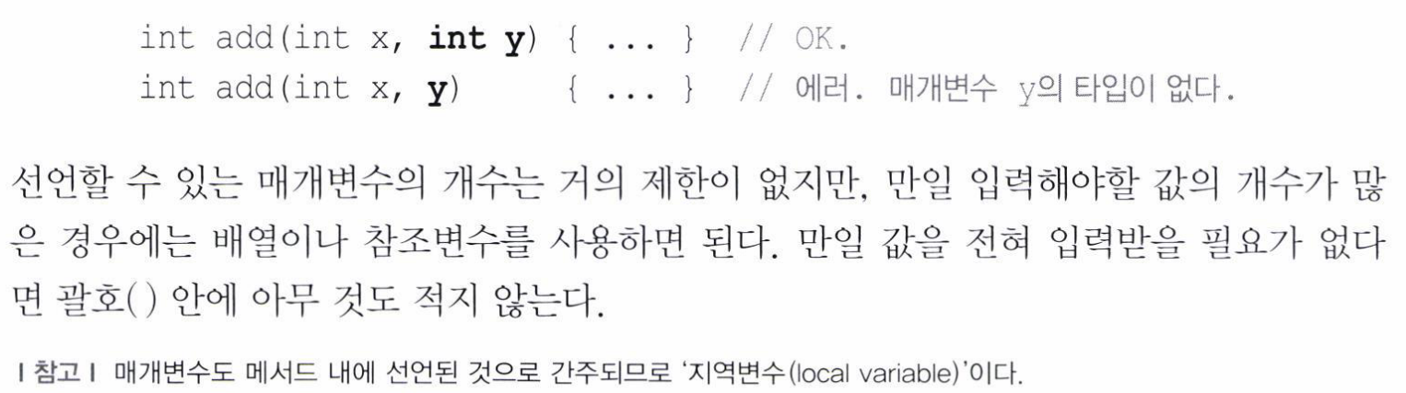

Slide 29
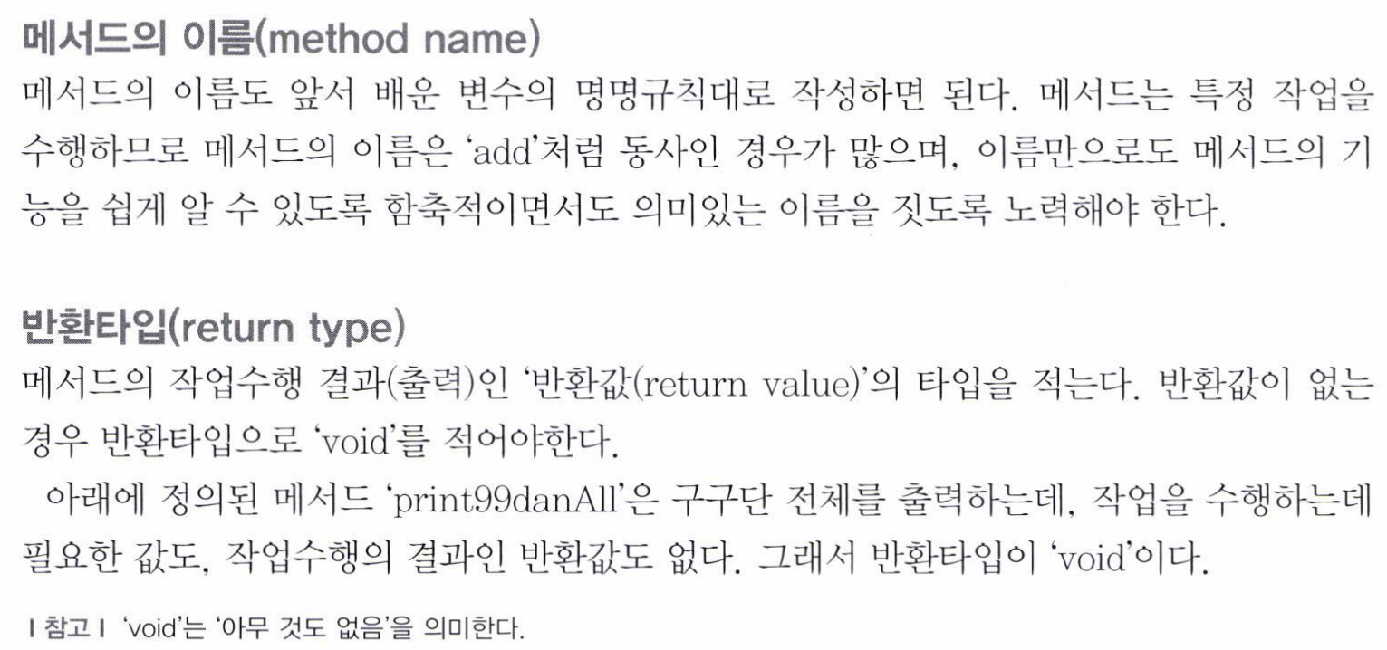
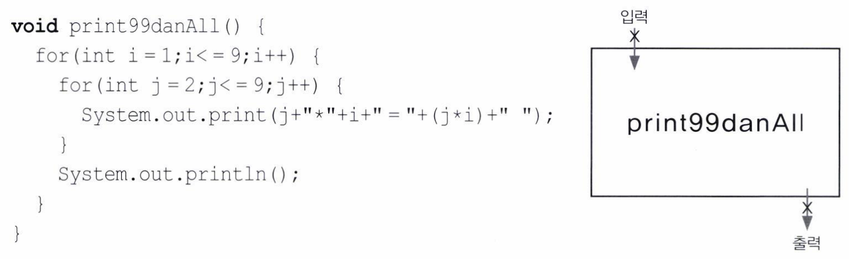

Slide 30
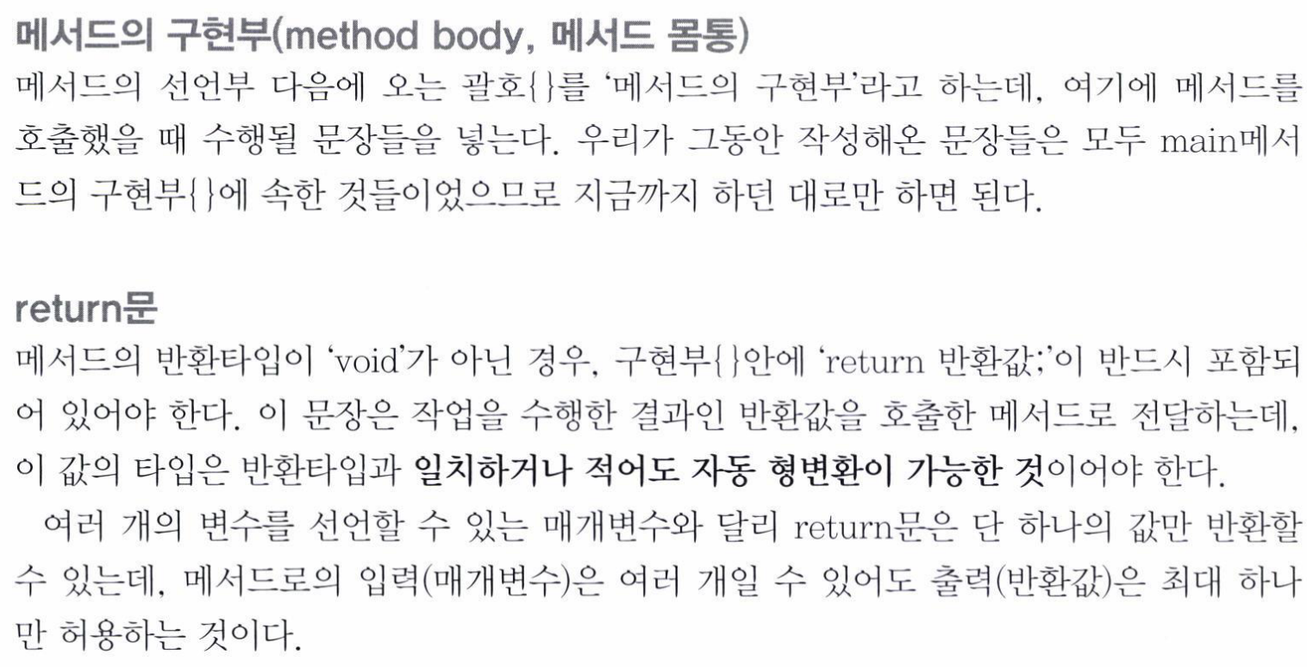
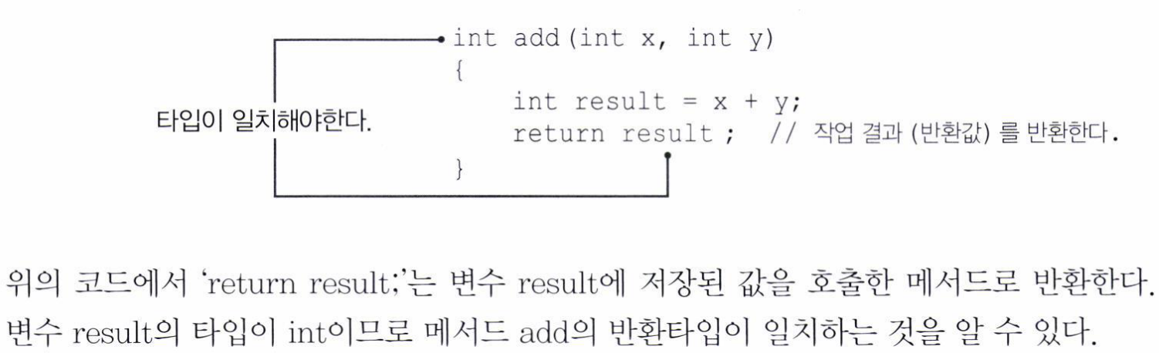

Slide 31
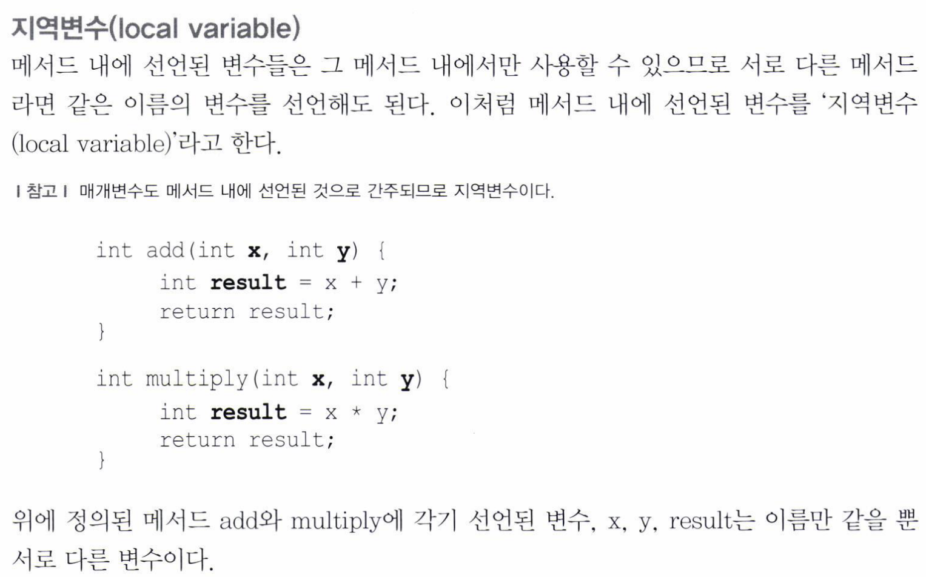

Slide 32
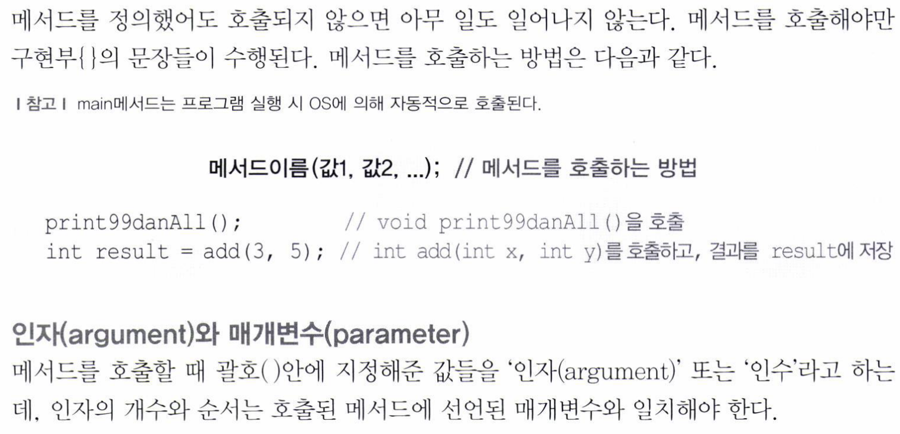

Slide 33
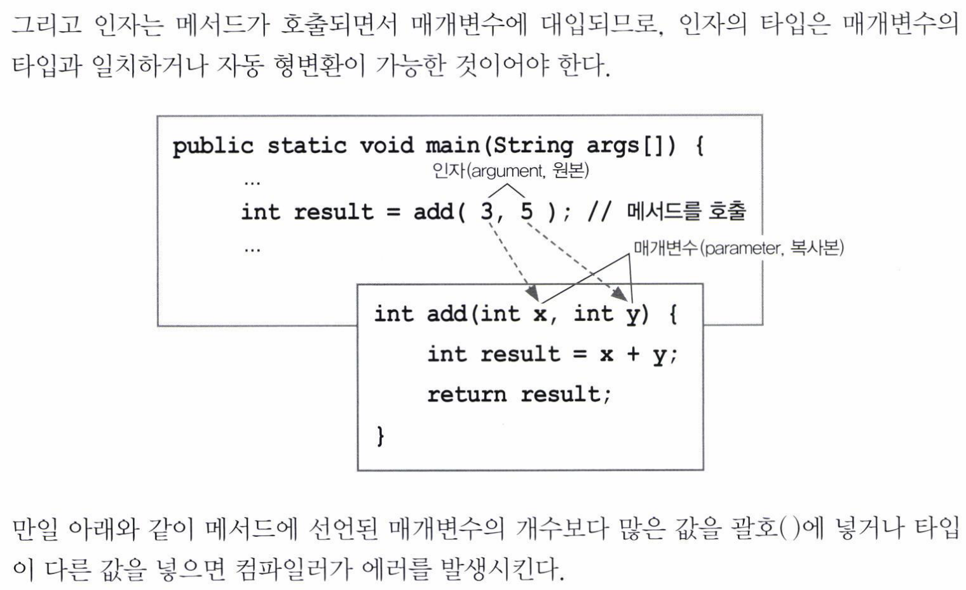

Slide 34
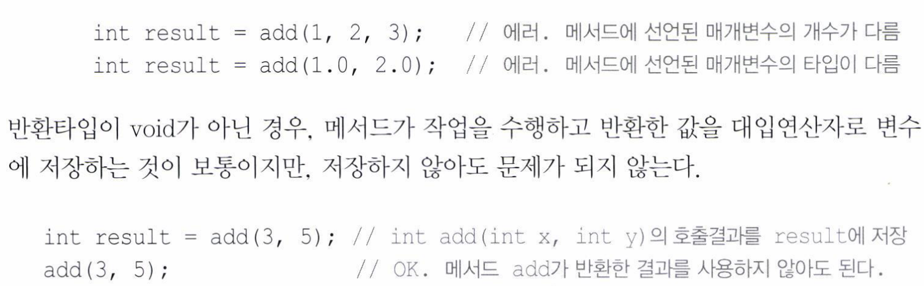

Slide 35
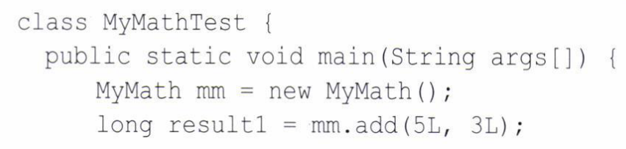
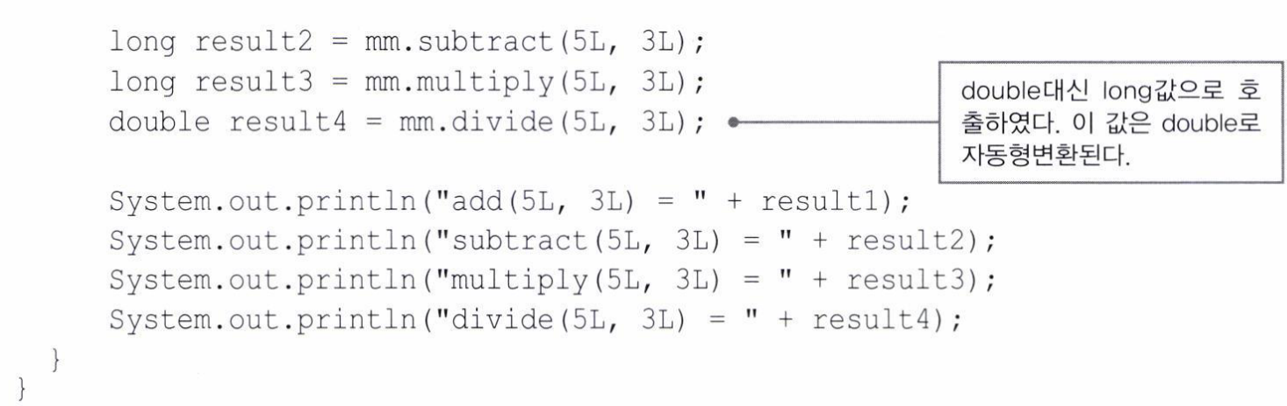

Slide 36
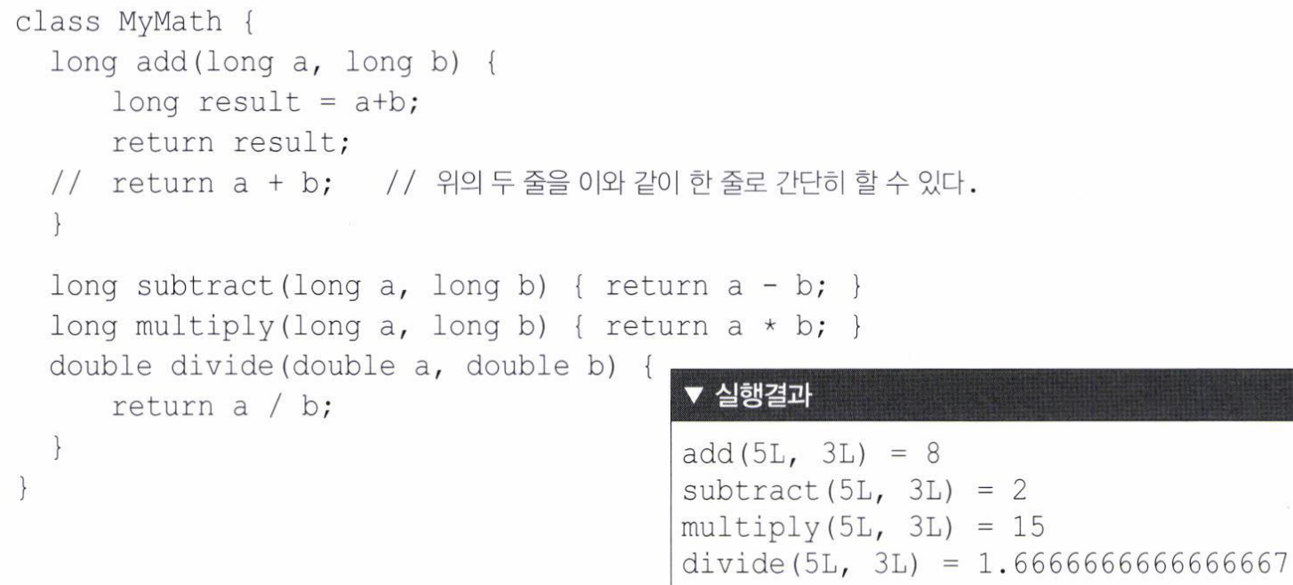

Slide 37
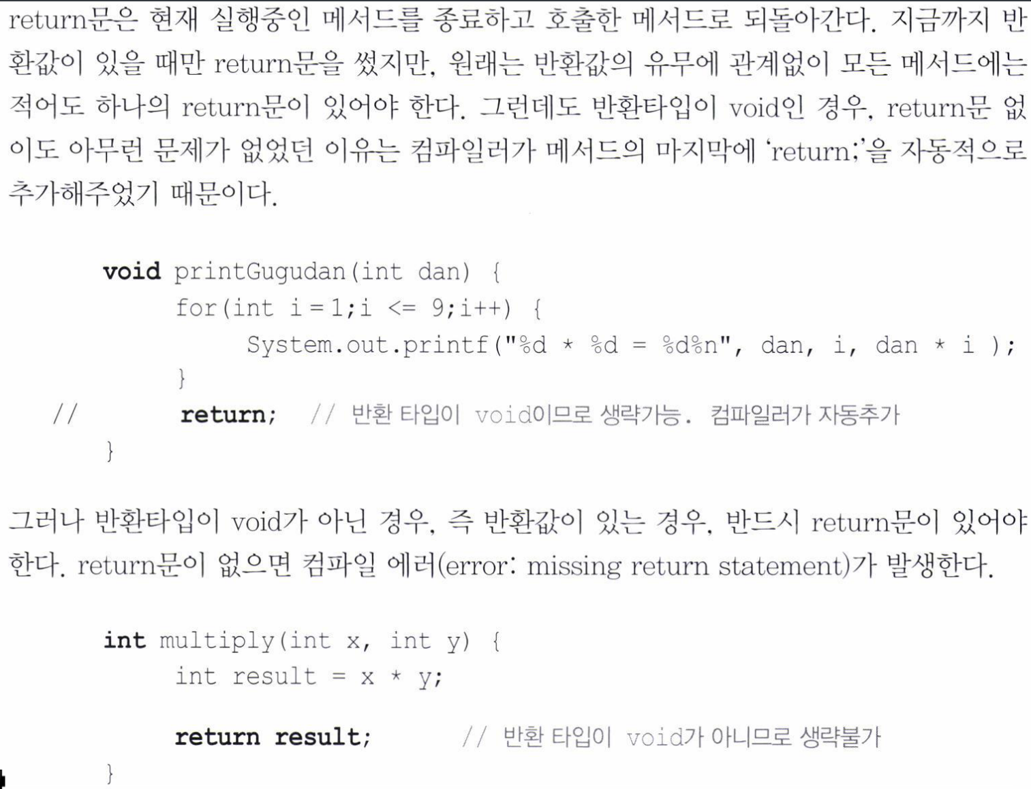

Slide 38
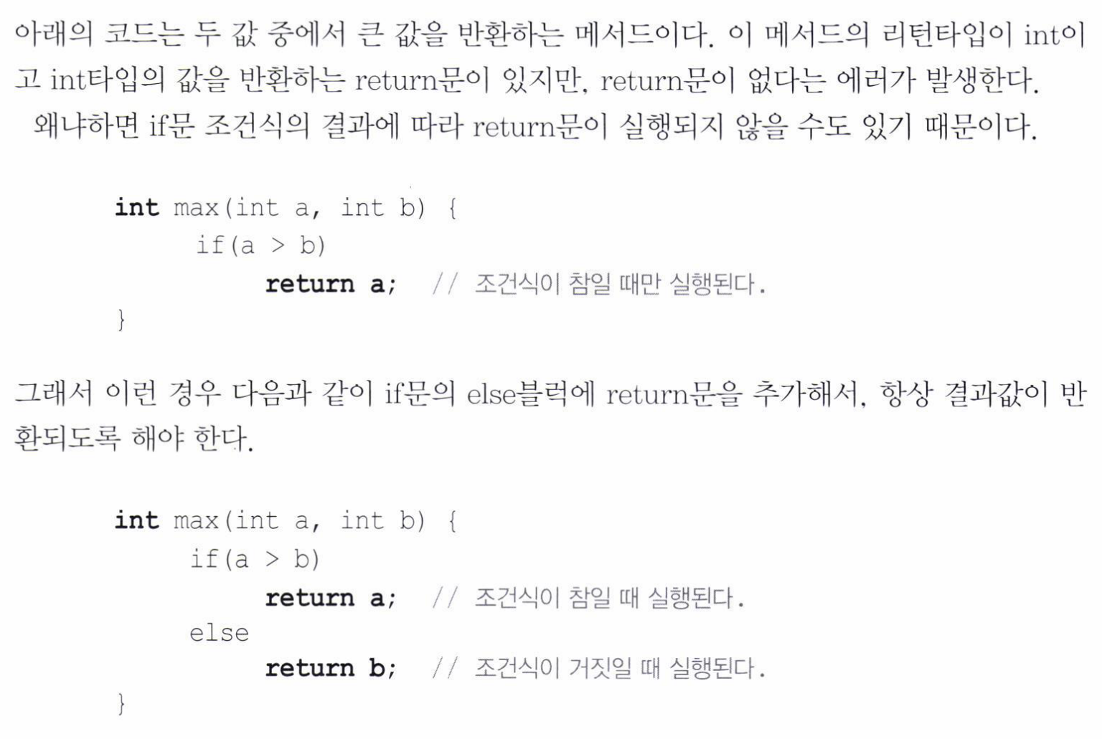

Slide 39


Slide 40


Slide 41




Slide 42




Slide 43



Slide 44


Slide 45




Slide 46



Slide 47


Slide 48


Slide 49


Slide 50


Slide 51


Slide 52



Slide 53


Slide 54


Slide 55


Slide 56




Slide 57


Slide 58


Slide 59


Slide 60


Slide 61



Slide 62


Slide 63


Slide 64




Slide 65


Slide 66


Slide 67


Slide 68
HTML
not yet…

Slide 69


